Slide 1
Leadership
Chapter
17
© 2007 Prentice Hall, Inc.
All rights reserved.

Slide 2
L E A R N I N G O U T L I N E
Follow this Learning Outline as you read and study this chapter.
Who Are Leaders and What Is Leadership
  Define leaders and leadership.
  Explain why managers should be leaders.
Early Leadership Theories
  Discuss what research has shown about leadership traits.
  Contrast the findings of the four behavioral leadership theories.
  Explain the dual nature of a leader’s behavior.
© 2007 Prentice Hall, Inc. All rights reserved.
17–<number>

Slide 3
L E A R N I N G O U T L I N E (cont’d)
Follow this Learning Outline as you read and study this chapter.
Contingency Theories of Leadership
  Explain how Fiedler’s theory of leadership is a contingency model.
  Contrast situational leadership theory and the leader participation model.
  Discuss how path-goal theory explains leadership.
Contemporary Views on Leadership
  Differentiate between transactional and transformational leaders.
  Describe charismatic and visionary leadership.
  Discuss what team leadership involves.
© 2007 Prentice Hall, Inc. All rights reserved.
17–<number>

Slide 4
L E A R N I N G O U T L I N E (cont’d)
Follow this Learning Outline as you read and study this chapter.
Leadership Issues in the Twenty-First Century
  Tell the five sources of a leader’s power.
  Discuss the issues today’s leaders face.
  Explain why leadership is sometimes irrelevant.
© 2007 Prentice Hall, Inc. All rights reserved.
17–<number>

Slide 5
Leaders and Leadership
Leader – Someone who can influence others and who has managerial authority
Example: Sarah, a department manager at a retail store, has the authority to assign tasks and make scheduling decisions. Because she communicates clearly, treats employees fairly, and consistently supports her team, the staff respects her and willingly follows her direction. Her ability to influence others—combined with her formal managerial authority—makes her a leader in the organization.
Leadership – What leaders do; the process of influencing a group to achieve goals
Example :During a major product launch, the team was unsure how to prioritize tasks. The project lead, Daniel, stepped in and clarified the goals, created a timeline, and assigned responsibilities based on each team member’s strengths. He regularly checked in, offered support, and motivated the group to stay focused. Through his actions—guiding, motivating, organizing, and influencing the team toward completing the launch on time—Daniel demonstrated leadership.
Ideally, all managers should be leaders
Although groups may have informal leaders who emerge, those are not the leaders we’re studying
Informal leaders are people who influence others without having official or formal authority.
© 2007 Prentice Hall, Inc. All rights reserved.
17–<number>

Slide 6
Early Leadership Theories
Trait Theories (1920s-30s)
  Research focused on identifying personal characteristics that differentiated leaders from nonleaders was unsuccessful.
  Later research on the leadership process identified seven traits associated with successful leadership:
    Drive, the desire to lead, honesty and integrity, self-confidence, intelligence, job-relevant knowledge, and extraversion.
© 2007 Prentice Hall, Inc. All rights reserved.
17–<number>

Slide 7
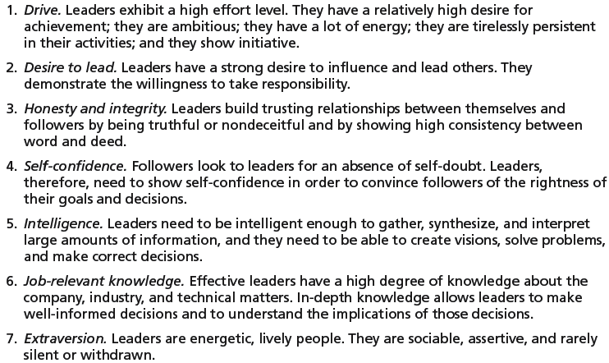
Exhibit 17–1 Seven Traits Associated with Leadership
Source: S. A. Kirkpatrick and E. A. Locke, “Leadership: Do Traits Really Matter?” Academy of Management Executive, May 1991, pp. 48–60; T. A. Judge, J. E. Bono, R. llies, and M. W. Gerhardt, “Personality and Leadership: A Qualitative and Quantitative Review,” Journal of Applied Psychology, August 2002, pp. 765–780.
© 2007 Prentice Hall, Inc. All rights reserved.
17–<number>

Slide 8
1. Drive:
Leaders with drive put in strong effort and stay motivated.
Example:
A project manager stays late to finalize a proposal, making sure the team meets the deadline. Their energy motivates others to work hard too.
2. Desire to Lead:
They genuinely want to guide others and take responsibility.
Example:
An employee volunteers to head a new task force and takes charge of organizing meetings, delegating tasks, and ensuring progress.
3. Honesty and Integrity:
They are truthful, consistent, and do what they say.
Example:
A supervisor admits a mistake in financial reporting rather than hiding it. Team members trust them more because they are transparent.
4. Self-Confidence:
Leaders believe in their decisions and communicate them clearly.
Example:
During a crisis, a team looks to the manager for direction. The manager confidently explains the plan, reducing employees’ fear and uncertainty.
© 2007 Prentice Hall, Inc. All rights reserved.
1–<number>

Slide 9
Cont….
5. Intelligence:
They can analyze information, solve problems, and make sound decisions.
Example:
A CEO studies market data, predicts a new trend, and shifts the company strategy—leading to higher sales.
6. Job-Relevant Knowledge
They understand their industry, job, and technical matters.
Example:
An IT team leader who knows programming languages can better guide the team, review code quality, and make informed decisions on technology.
7. Extraversion
They are outgoing, sociable, and communicate easily.
Example:
A sales manager enthusiastically interacts with clients and motivates their team through open communication and positive engagement.
© 2007 Prentice Hall, Inc. All rights reserved.
1–<number>

Slide 10
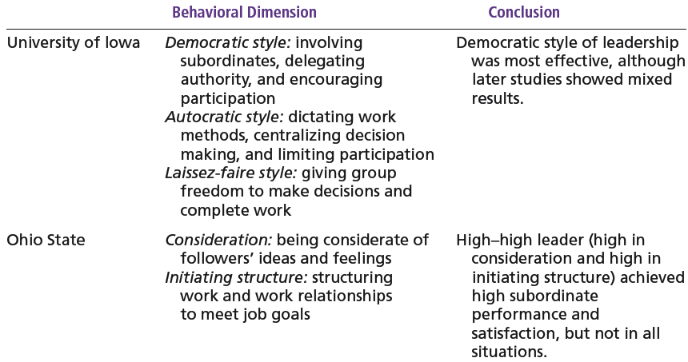
Exhibit 17–2 Behavioral Theories of Leadership
© 2007 Prentice Hall, Inc. All rights reserved.
17–<number>

Slide 11
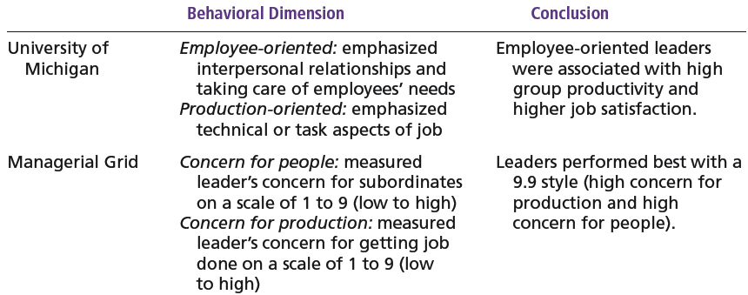
Exhibit 17–2 (cont’d) Behavioral Theories of Leadership
© 2007 Prentice Hall, Inc. All rights reserved.
17–<number>

Slide 12
Early Leadership Theories (cont’d)
Behavioral Theories
  University of Iowa Studies (Kurt Lewin)
    Identified three leadership styles:
      Autocratic style: Leader makes decisions alone, controls work methods, and gives strict instructions centralized authority, low participation
      Democratic style: Leader involves employees, asks for input, shares authority. involvement, high participation, feedback
      Laissez faire style: Leader gives full freedom; employees make decisions themselves hands-off management
    Research findings: mixed results
      No specific style was consistently better for producing better performance
      Employees were more satisfied under a democratic leader than an autocratic leader.
© 2007 Prentice Hall, Inc. All rights reserved.
17–<number>

Slide 13
Early Leadership Theories (cont’d)
Behavioral Theories (cont’d)
  Ohio State Studies
    Identified two dimensions of leader behavior
      Initiating structure: the role of the leader in defining his or her role and the roles of group members
      This is about task-oriented behavior.
      The leader clearly defines:
      what the team needs to do
      how to do it
      who will do which task
      deadlines, rules, and work processes
© 2007 Prentice Hall, Inc. All rights reserved.
17–<number>

Slide 14
Early Leadership Theories (cont’d)
Behavioral Theories (cont’d)
  Ohio State Studies
      Consideration: the leader’s mutual trust and respect for group members’ ideas and feelings. Influence. This is about people-oriented behavior.
      The leader shows:
      Trust ,respect, concern for employees’ needs. Good communication,empathy.leadership effectiveness.
    Research findings: mixed results
      High-high leaders (A leader who combines high initiating structure + high consideration is usually very effective.) generally, but not always, achieved high group task performance and satisfaction
      Evidence indicated that situational factors appeared to strongly
© 2007 Prentice Hall, Inc. All rights reserved.
17–<number>

Slide 15
Early Leadership Theories (cont’d)
Behavioral Theories (cont’d)
  University of Michigan Studies
    Identified two dimensions of leader behavior
      Employee oriented: emphasizing personal relationships
      Production oriented: emphasizing task accomplishment
    Research findings:
      Leaders who are employee oriented are strongly associated with high group productivity and high job satisfaction.
© 2007 Prentice Hall, Inc. All rights reserved.
17–<number>

Slide 16
University of Michigan Studies — Explained
The University of Michigan researchers studied what makes leaders effective.
They identified two main leadership behaviors:
1. Employee-Oriented Leadership
This leader focuses on people.
Characteristics:
Builds strong personal relationships
Shows concern for employees’ well-being
Listens to employees
Encourages participation
Treats everyone with respect
Example:
A team leader regularly checks on how employees are feeling, supports them when they face challenges, and encourages teamwork.
They celebrate small achievements and make employees feel valued.
Result: Employees become more motivated, loyal, and satisfied.
This leads to higher productivity.
© 2007 Prentice Hall, Inc. All rights reserved.
1–<number>

Slide 17
2. Production-Oriented Leadership
This leader focuses on tasks and output.
Characteristics:
Emphasizes deadlines and work targets
Monitors performance closely
Focuses on getting the job done
Less emphasis on personal needs of employees
Example:
A manager instructs the team to meet a strict monthly target, checks progress daily, and expects everyone to stay focused only on tasks.
Result:
Work gets completed, but employees may feel stressed or unimportant.
© 2007 Prentice Hall, Inc. All rights reserved.
1–<number>

Slide 18
The Managerial Grid
Managerial Grid
  Appraises leadership styles using two dimensions:
    Concern for people
    Concern for production
  Places managerial styles in five categories:
    Impoverished management
    Task management
    Middle-of-the-road management
    Country club management
    Team management
© 2007 Prentice Hall, Inc. All rights reserved.
17–<number>

Slide 19
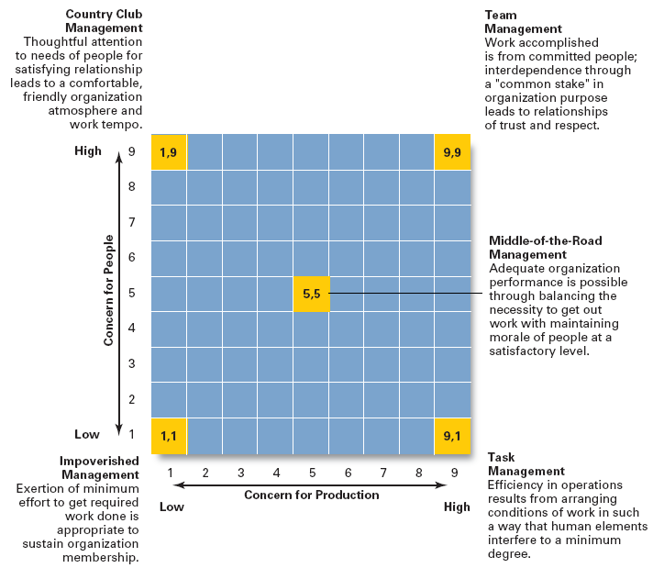
Exhibit 17–3
The
Managerial
Grid
Source: Reprinted by permission of Harvard Business Review. An exhibit from “Breakthrough in Organization Development” by Robert R. Blake, Jane S. Mouton, Louis B. Barnes, and Larry E. Greiner, November–December 1964, p. 136. Copyright © 1964 by the President and Fellows of Harvard College. All rights reserved.
© 2007 Prentice Hall, Inc. All rights reserved.
17–<number>

Slide 20
The Managerial Grid—developed by Blake and Mouton—shows five major leadership styles based on two factors:
1. Concern for People (Vertical Axis)
How much the leader cares about employee needs, morale, and relationships.
2. Concern for Production (Horizontal Axis)
How much the leader focuses on achieving goals, productivity, and results.
Each style is rated on a scale of 1 to 9, where:
1 = Low concern
9 = High concern
The Five Leadership Styles
1️⃣ Impoverished Management (1,1)
Low concern for people + Low concern for production
Leader does the minimum.
No interest in motivating staff.
Just tries to survive in the organization.
Result:
Low efficiency, low morale.
2️⃣ Country Club Management (1,9)
High concern for people + Low concern for production
Leader focuses on creating a friendly, comfortable atmosphere.
Avoids pressure and conflict.
Work is pleasant but productivity is low.
Result:
Happy employees, weak performance.
© 2007 Prentice Hall, Inc. All rights reserved.
1–<number>

Slide 21
3️⃣ Task Management (9,1)
High concern for production + Low concern for people
Very strict, controlling, and work-focused.
Workers are treated like tools for output.
Rules and procedures are emphasized.
Result:
High productivity but unhappy employees.
4️⃣ Middle-of-the-Road Management (5,5)
Moderate concern for people + Moderate concern for production
Tries to balance work output and employee needs.
Not too strict, not too friendly.
Avoids extremes.
Result:
Average performance, no excellence.
5️⃣ Team Management (9,9)
High concern for people + High concern for production
Best leadership style.
Leader builds trust, respect, teamwork, and high performance.
Employees feel motivated and involved.
Result:
Strong productivity + high employee satisfaction.
© 2007 Prentice Hall, Inc. All rights reserved.
1–<number>

Slide 22
Contingency Theories of Leadership
The Fiedler Model (cont’d)
  Proposes that effective group performance depends upon the proper match between the leader’s style of interacting with followers and the degree to which the situation allows the leader to control and influence.
  Assumptions:
    A certain leadership style should be most effective in different types of situations.
    Leaders do not readily change leadership styles.
      Matching the leader to the situation or changing the situation to make it favorable to the leader is required.
© 2007 Prentice Hall, Inc. All rights reserved.
17–<number>

Slide 23
Contingency Theories… (cont’d)
The Fiedler Model (cont’d)
  Least-preferred co-worker (LPC) questionnaire
    Determines leadership style by measuring responses to 18 pairs of contrasting adjectives.
      High score: a relationship-oriented leadership style
      Low score: a task-oriented leadership style
  Situational factors in matching leader to the situation:
    Leader-member relations
    Task structure
    Position power
© 2007 Prentice Hall, Inc. All rights reserved.
17–<number>

Slide 24
Fiedler’s Contingency Model
Fiedler's model says:
👉 No single leadership style works best in all situations.
👉 Leadership effectiveness depends on matching the right leader with the right situation.
A leader’s effectiveness depends on two things:
The leader’s style
– This is seen as fixed (you cannot easily change your natural leadership style).
The favorableness of the situation
– How much control the situation gives to the leader.
If the leader’s style fits the situation → performance improves.
© 2007 Prentice Hall, Inc. All rights reserved.
1–<number>

Slide 25
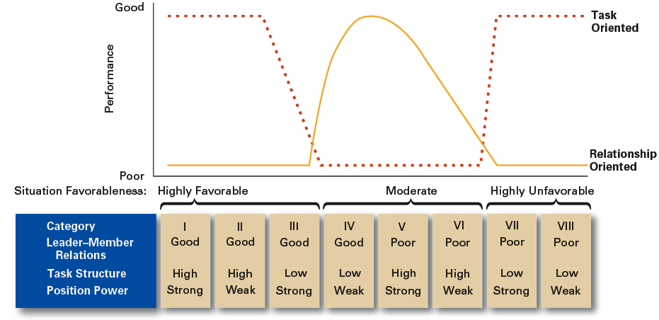
Exhibit 17–4 Findings of the Fiedler Model
© 2007 Prentice Hall, Inc. All rights reserved.
17–<number>

Slide 26
Contingency Theories… (cont’d)
Hersey and Blanchard’s Situational Leadership Theory (SLT)
  Argues that successful leadership is achieved by selecting the right leadership style which is contingent on the level of the followers’ readiness.
    Acceptance: leadership effectiveness depends on whether followers accept or reject a leader.
    Readiness: the extent to which followers have the ability and willingness to accomplish a specific task.
  Leaders must relinquish control over and contact with followers as they become more competent.
© 2007 Prentice Hall, Inc. All rights reserved.
17–<number>

Slide 27
Situational Leadership Theory argues that there is no single best leadership style. Instead, effective leaders adjust their style depending on the “readiness” of their followers—that is, followers’ ability and willingness to carry out a specific task.
1. Leadership effectiveness depends on follower acceptance
SLT suggests that leadership only works if followers accept or “buy into” the leader’s direction.
A leader can adopt any style, but it won’t be effective unless followers are willing to follow.
This means leadership success is contingent on the relationship between leader behavior and follower response.
© 2007 Prentice Hall, Inc. All rights reserved.
1–<number>

Slide 28
2. Readiness of followers
Readiness (sometimes called “maturity”) refers to how capable and motivated followers are to perform a particular task.
It has two components:
Ability – Do they have the skills, knowledge, and competence?
Willingness – Are they confident, motivated, and committed?
Leaders must assess where followers are on this readiness spectrum before choosing a leadership style.
© 2007 Prentice Hall, Inc. All rights reserved.
1–<number>

Slide 29
Contingency Theories… (cont’d)
Hersey and Blanchard’s Situational Leadership Theory (SLT)
  Creates four specific leadership styles incorporating Fiedler’s two leadership dimensions:
    Telling: high task-low relationship leadership
    Selling: high task-high relationship leadership
    Participating: low task-high relationship leadership
    Delegating: low task-low relationship leadership
© 2007 Prentice Hall, Inc. All rights reserved.
17–<number>

Slide 30
Hersey and Blanchard’s Situational Leadership Theory (SLT)
Style | Task Behavior | Relationship Behavior | Best for Followers Who…
Telling | High | Low | Can’t do the task and aren’t confident or motivated
Selling | High | High | Can’t do the task but are motivated and want to learn
Participating | Low | High | Can do the task but lack confidence or commitment
Delegating | Low | Low | The leader provides minimal direction and minimal support.
© 2007 Prentice Hall, Inc. All rights reserved.
1–<number>

Slide 31
Contingency Theories… (cont’d)
Hersey and Blanchard’s Situational Leadership Theory (SLT)
  Posits four stages follower readiness:
    R1: followers are unable and unwilling
    R2: followers are unable but willing
    R3: followers are able but unwilling
    R4: followers are able and willing
© 2007 Prentice Hall, Inc. All rights reserved.
17–<number>

Slide 32
Contingency Theories… (cont’d)
Leader Participation Model (Vroom and Yetton)
  Posits that leader behavior must be adjusted to reflect the task structure—whether it is routine, nonroutine, or in between—based on a sequential set of rules (contingencies) for determining the form and amount of follower participation in decision making in a given situation.
© 2007 Prentice Hall, Inc. All rights reserved.
17–<number>

Slide 33
Routine Task Example
Situation:
In a factory, everything on the assembly line is done the same way every day. The machines also have a regular maintenance schedule. Now, it’s time to update the schedule for one machine.
Why is this a routine task?
The steps are already known
There are clear rules
Nothing new or uncertain is happening
What should the leader do?
The leader should make the decision alone (autocratic style A1).
Why make the decision alone?
Because:
The task is simple
The leader already knows what to do
Asking the workers won’t change anything
What is the final result?
The leader updates the maintenance schedule and then tells the team.
© 2007 Prentice Hall, Inc. All rights reserved.
1–<number>

Slide 34
Task in Between (Partly Structured)
Situation:
A manager must decide whether to introduce a new work-from-home policy. There are some guidelines, but the impact is uncertain.
Task type: Partly structured.
Leader decision:
Use a consultative style (C2) — ask the team as a group for input, but leader makes final decision.
Why?
Some information is known, some is uncertain
Employee opinions matter
But the final responsibility stays with the leader
Outcome:
Leader gathers feedback and then decides.
© 2007 Prentice Hall, Inc. All rights reserved.
1–<number>

Slide 35
Nonroutine Task (Complex Problem)
Situation:
A company must decide how to respond to a sudden drop in customer satisfaction. The cause is unclear, and many departments are involved.
Task type: Nonroutine, complex, uncertain.
Leader decision:
Use a group-based style (G2) — leader and team discuss and make the decision together.
Why?
Leader does not have all the information
Team members have different insights (support, product, IT, etc.)
High commitment is needed to implement the solution
Outcome:
Everyone collaborates to diagnose the problem and agree on a solution.
© 2007 Prentice Hall, Inc. All rights reserved.
1–<number>

Slide 36

Contingency Theories… (cont’d)
Leader Participation Model Contingencies:
  Decision significance
  Importance of commitment
  Leader expertise
  Likelihood of commitment
  Group support
  Group expertise
  Team competence
© 2007 Prentice Hall, Inc. All rights reserved.
17–<number>

Slide 37
Exhibit 17–5 Leadership Styles in the Vroom Leader Participation Model
Decide: Leader makes the decision alone and either announces or sells it to group.
Consult Individually: Leader presents the problem to group members individually, gets their suggestions, and then makes the decision.
Consult Group: Leader presents the problem to group members in a meeting, gets their suggestions, and then makes the decision.
Facilitate: Leader presents the problem to the group in a meeting and, acting as facilitator, defines the problem and the boundaries within which a decision must be made.
Delegate: Leader permits the group to make the decision within prescribed limits.
Source: Based on V. Vroom, “Leadership and the Decision-Making Process,” Organizational Dynamics, vol. 28, no. 4 (2000), p. 84.
© 2007 Prentice Hall, Inc. All rights reserved.
17–<number>

Slide 38
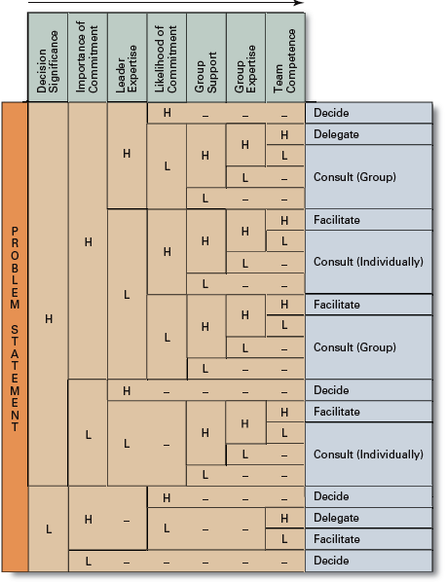
Exhibit 17–6
Time-Driven
Model
Source: Adapted from V. Vroom, “Leadership and the Decision-Making Process,” Organizational Dynamics, vol. 28, no. 4 (2000), p. 87.
© 2007 Prentice Hall, Inc. All rights reserved.
17–<number>

Slide 39
Contingency Theories… (cont’d)
Path-Goal Model
  States that the leader’s job is to assist his or her followers in attaining their goals and to provide direction or support to ensure their goals are compatible with organizational goals.
  The Path-Goal Leadership Model states that a leader’s main role is to guide, support, and motivate followers so they can achieve their goals. The leader must also ensure that these goals are aligned with organizational objectives. Depending on the situation, the leader may change their leadership style to help employees overcome obstacles and perform effectively.
  Leaders assume different leadership styles at different times depending on the situation:
    Directive leader
    Supportive leader
    Participative leader
    Achievement oriented leader
© 2007 Prentice Hall, Inc. All rights reserved.
17–<number>

Slide 40
Leadership Styles with Examples
1. Directive Leader
Explanation:
The leader provides clear instructions, sets expectations, defines tasks, and tells employees exactly what needs to be done.
Example:
A supervisor in a manufacturing unit gives step-by-step instructions on how to operate a new machine to ensure safety and accuracy.
2. Supportive Leader
Explanation:
The leader shows concern for employees’ well-being, creates a friendly environment, and provides emotional support.
Example:
A team is stressed during a tight deadline. The manager encourages them, provides flexibility, and helps reduce pressure.
© 2007 Prentice Hall, Inc. All rights reserved.
1–<number>

Slide 41
3. Participative Leader
Explanation:
The leader includes employees in decision-making, seeks their input, and values their ideas before taking action.
Example:
Before launching a new service, a manager holds a meeting to gather feedback from staff and incorporates their suggestions into the final plan.
4. Achievement-Oriented Leader
Explanation:
The leader sets challenging goals, expects high performance, and pushes employees to reach their full potential.
Example:
A sales manager motivates the team by setting a high but achievable sales target and provides resources to help them exceed it.
© 2007 Prentice Hall, Inc. All rights reserved.
1–<number>

Slide 42
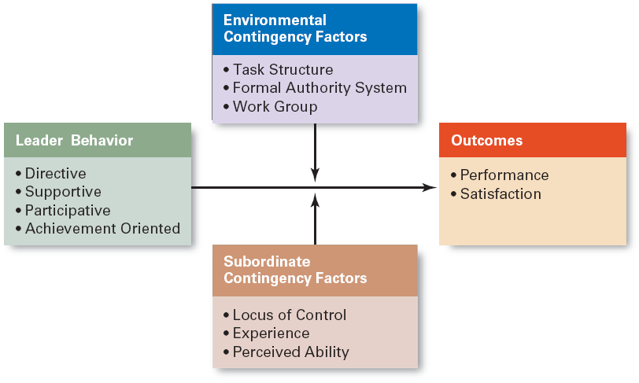
Exhibit 17–7 Path-Goal Theory
© 2007 Prentice Hall, Inc. All rights reserved.
17–<number>

Slide 43
Contemporary Views on Leadership
Transactional Leadership
  Leaders who guide or motivate their followers in the direction of established goals by clarifying role and task requirements.
  What it says:
  Transactional leaders guide or motivate followers toward achieving established goals by clarifying roles, responsibilities, and task requirements.
  Example:
  A manager sets targets for employees and offers bonuses for meeting them.
© 2007 Prentice Hall, Inc. All rights reserved.
17–<number>

Slide 44
Contemporary Views on Leadership
Transformational Leadership
  Leaders who inspire followers to transcend their own self-interests for the good of the organization by clarifying role and task requirements.
  Leaders who also are capable of having a profound and extraordinary effect on their followers.
  What it says:
  Transformational leaders inspire followers to go beyond their own self-interest for the benefit of the organization.
  They motivate people through vision, inspiration, enthusiasm, and personal influence.
  Example:
  A school principal introduces a vision to make the school one of the top institutions in the region.She motivates teachers by encouraging innovative teaching methods, recognizes their efforts publicly, and creates a culture of continuous improvement.
© 2007 Prentice Hall, Inc. All rights reserved.
17–<number>

Slide 45
Contemporary Views…(cont’d)
Charismatic Leadership
  An enthusiastic, self-confident leader whose personality and actions influence people to behave in certain ways.
  Characteristics of charismatic leaders:
    Have a vision.
    Are able to articulate the vision.
    Are willing to take risks to achieve the vision.
    Are sensitive to the environment and follower needs.
    Exhibit behaviors that are out of the ordinary.
© 2007 Prentice Hall, Inc. All rights reserved.
17–<number>

Slide 46
Benazir Bhutto as a Charismatic Leader
Benazir Bhutto is often remembered as a strong charismatic leader because she inspired people through her personality, courage, and vision—not just her position.
Example: Her Return to Pakistan in 1986
When Benazir Bhutto returned to Pakistan from exile in 1986, millions of people came out on the streets to welcome her.
There were crowds stretching for miles, cheering for her, following her car, and listening to her speeches with excitement.
Why this shows charisma:
Inspiring Personality:
She spoke with energy and passion, giving people hope for democracy.
Confidence and Courage:
Even though her family had suffered and the political situation was dangerous, she confidently stood in front of huge crowds and promised change.
Vision for the Future:
She talked about restoring democracy, ending dictatorship, and improving the lives of ordinary people.
People followed her because they believed in her vision.
© 2007 Prentice Hall, Inc. All rights reserved.
1–<number>

Slide 47
Contemporary Views…(cont’d)
Visionary Leadership
  A leader who creates and articulates a realistic, credible, and attractive vision of the future that improves upon the present situation.
Visionary leaders have the ability to:
  Explain the vision to others.
  Express the vision not just verbally but through behavior.
  Extend or apply the vision to different leadership contexts.
© 2007 Prentice Hall, Inc. All rights reserved.
17–<number>

Slide 48
Contemporary Views…(cont’d)
Team Leadership Characteristics
  Having patience to share information: A good team leader communicates openly and consistently, ensuring everyone understands tasks, goals, and expectations.
  Being able to trust others and to give up authority: They empower team members, allow them to make decisions
  Understanding when to intervene: They know when to step in to solve problems and when to stay back and let the team handle situations independently.
© 2007 Prentice Hall, Inc. All rights reserved.
17–<number>

Slide 49
Team Leader’s Job
  Managing the team’s external boundary: This means acting as a link between the team and the outside environment—other departments, management, clients, etc.
  Facilitating the team process
    Coaching, facilitating, handling disciplinary problems, reviewing team and individual performance, training, and communication
    Example: A project team is working on a new website.
    The team leader shares all necessary updates from management, trusts the web developers to make design decisions, and only steps in when a conflict arises.
    They coordinate with other departments, coach teammates on improving their work, review progress regularly, and ensure smooth communication.
© 2007 Prentice Hall, Inc. All rights reserved.
1–<number>

Slide 50
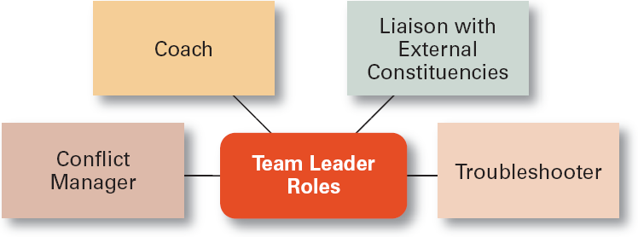
Exhibit 17–8 Specific Team Leadership Roles
© 2007 Prentice Hall, Inc. All rights reserved.
17–<number>

Slide 51
Leadership Issues in the 21st Century
Managing Power
  Legitimate power
    The power a leader has as a result of his or her position.
  Coercive power
    The power a leader has to punish or control.
  Reward power
    The power to give positive benefits or rewards.
  Expert power
    The influence a leader can exert as a result of his or her expertise, skills, or knowledge.
  Referent power
    The power of a leader that arise because of a person’s desirable resources or admired personal traits.
© 2007 Prentice Hall, Inc. All rights reserved.
17–<number>

Slide 52
Developing Credibility and Trust
Credibility (of a Leader)
  The assessment of a leader’s honesty, competence, and ability to inspire by his or her followers
Trust
  Is the belief of followers and others in the integrity, character, and ability of a leader.
    Dimensions of trust: integrity, competence, consistency, loyalty, and openness.
  Is related to increases in job performance, organizational citizenship behaviors, job satisfaction, and organization commitment.
  Example: A manager always communicates honestly, supports employees, keeps commitments, and listens to concerns.
  Because of this, the team trusts the manager, works harder, and stays committed during difficult projects.
© 2007 Prentice Hall, Inc. All rights reserved.
17–<number>

Slide 53
Exhibit 17–9 Suggestions for Building Trust
Practice openness.
Be fair.
Speak your feelings.
Tell the truth.
Show consistency.
Fulfill your promises.
Maintain confidences.
Demonstrate competence.
© 2007 Prentice Hall, Inc. All rights reserved.
17–<number>

Slide 54
Providing Ethical Leadership
Ethical leadership involves guiding and influencing others in a way that is morally right, honest, and socially responsible. Leaders integrate ethics into their leadership by:
  Foster moral virtue through changes in attitudes and behaviors-encouraging positive attitudes and behaviors among followers.
  Use their charisma in socially constructive ways: inspiring people in socially responsible ways
  Promote ethical behavior by exhibiting their personal traits of honesty and integrity-promoting ethical behavior through their own actions.
© 2007 Prentice Hall, Inc. All rights reserved.
17–<number>

Slide 55
Moral Leadership
Involves addressing the means that a leader uses to achieve goals as well as the moral content of those goals. Moral leadership focuses not only on achieving goals, but also on how those goals are achieved. It considers:
The ethical means used to reach objectives.
The moral content of the goals themselves.
Example: A CEO aims to expand the company internationally. She ensures all business practices comply with ethical standards, avoids exploitation, and respects local cultures. She motivates employees by modeling honesty, transparency, and social responsibility. Employees follow her guidance not just for business success, but also because they respect her moral example.
© 2007 Prentice Hall, Inc. All rights reserved.
1–<number>

Slide 56
Empowering Employees
Empowerment
  Involves increasing the decision-making discretion of workers such that teams can make key operating decisions in develop budgets, scheduling workloads, controlling inventories, and solving quality problems.
  Why empower employees?
Faster decisions: Employees can respond quickly to problems without waiting for managerial approval.
Better management focus: Frees managers from routine decisions so they can focus on strategic issues.
Increased accountability and motivation: Employees feel trusted and responsible, improving engagement and performance.
© 2007 Prentice Hall, Inc. All rights reserved.
17–<number>

Slide 57

Cross-Cultural Leadership
Universal Elements of Effective Leadership
  Vision
  Foresight
  Providing encouragement
  Trustworthiness
  Dynamism
  Positiveness
  Proactiveness
© 2007 Prentice Hall, Inc. All rights reserved.
17–<number>

Slide 58
Cross-cultural leadership refers to leading people from different cultural backgrounds effectively. It requires understanding cultural differences while applying universal leadership principles that work across cultures.
Universal Elements of Effective Leadership
Vision – A clear and inspiring picture of the future.
Foresight – Ability to anticipate challenges and opportunities.
Providing encouragement – Motivating and supporting followers.
Trustworthiness – Being reliable, honest, and ethical.
Dynamism – Showing energy and enthusiasm.
Positiveness – Maintaining a positive attitude even in difficulties.
Proactiveness – Taking initiative rather than waiting for events to happen.
© 2007 Prentice Hall, Inc. All rights reserved.
1–<number>

Slide 59
Example
A multinational company has employees from five countries.
The manager clearly communicates the company’s vision and goals (vision).
Anticipates potential cultural misunderstandings and plans team-building activities (foresight).
Encourages participation, praises achievements, and resolves conflicts fairly (encouragement, trustworthiness).
Maintains energy, optimism, and takes initiative in launching global projects (dynamism, positiveness, proactiveness).
This approach ensures that the team works effectively despite cultural differences.
© 2007 Prentice Hall, Inc. All rights reserved.
1–<number>

Slide 60
Exhibit 17–10 Selected Cross-Cultural Leadership Findings
Korean leaders are expected to be paternalistic toward employees.
Arab leaders who show kindness or generosity without being asked to do so are seen by other Arabs as weak.
Japanese leaders are expected to be humble and speak frequently.
Scandinavian and Dutch leaders who single out individuals with public praise are likely to embarrass, not energize, those individuals.
Effective leaders in Malaysia are expected to show compassion while using more of an autocratic than a participative style.
Effective German leaders are characterized by high performance orientation, low compassion, low self-protection, low team orientation, high autonomy, and high participation.
Source: Based on J. C. Kennedy, “Leadership in Malaysia: Traditional Values, International Outlook,” Academy of Management Executive, August 2002, pp. 15–17; F.C. Brodbeck, M. Frese, and M. Javidan, “Leadership Made in Germany: Low on Compassion, High on Performance,” Academy of Management Executive, February 2002, pp. 16–29; M. F. Peterson and J. G. Hunt, “International Perspectives on International Leadership,” Leadership Quarterly, Fall 1997, pp. 203–31; R. J. House and R. N. Aditya, “The Social Scientific Study of Leadership: Quo Vadis?” Journal of Management, vol. 23, no. 3, (1997), p. 463; and R. J. House, “Leadership in the Twenty-First Century,” in A. Howard (ed.), The Changing Nature of Work (San Francisco: Jossey-Bass, 1995), p. 442.
© 2007 Prentice Hall, Inc. All rights reserved.
17–<number>

Slide 61
Gender Differences and Leadership
Research Findings
  Males and females use different styles:
    Women tend to adopt a more democratic or participative style unless in a male-dominated job.
    Women tend to use transformational leadership.
    Men tend to use transactional leadership.
© 2007 Prentice Hall, Inc. All rights reserved.
17–<number>

Slide 62
Women’s Leadership Style:
  Often democratic or participative, involving team members in decision-making.
  Frequently transformational, inspiring and motivating followers to exceed expectations.
  Exception: In male-dominated fields, women may adapt to more directive styles.
Example:
A female manager in a marketing team encourages input from all team members, motivates them with a shared vision, and supports creative solutions.
© 2007 Prentice Hall, Inc. All rights reserved.
1–<number>

Slide 63
Men’s Leadership Style:
  Often transactional, focusing on structure, tasks, and rewards for performance.
Example:
A male project manager sets clear deadlines and performance targets, offering bonuses for meeting goals.
© 2007 Prentice Hall, Inc. All rights reserved.
1–<number>

Slide 64
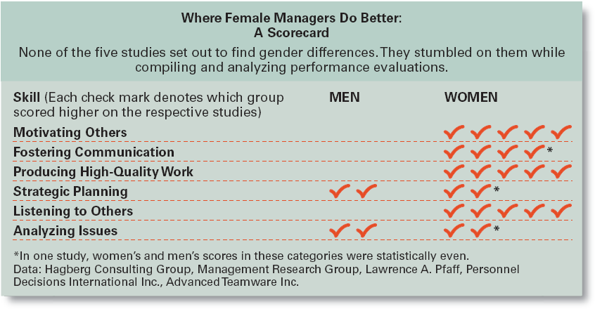
Exhibit 17–11 Where Female Managers Do Better: A Scorecard
Source: R. Sharpe, “As Leaders, Women Rule,” BusinessWeek, November 20. 2000, p. 75.
© 2007 Prentice Hall, Inc. All rights reserved.
17–<number>

Slide 65
Basics of Leadership
Give people a reason to come to work: Inspire and motivate employees by making their work meaningful.
Example: A manager shares how each team member’s work contributes to improving customer satisfaction
Be loyal to the organization’s people
© 2007 Prentice Hall, Inc. All rights reserved.
17–<number>

Slide 66
Spend time with people who do the real work of the organization. Engage with employees on the front lines to understand challenges and processes. Example: A factory supervisor regularly visits the production floor to talk with workers.
Be more open and more candid about what business practices are acceptable and proper and how the unacceptable ones should be fixed
Clearly communicate organizational standards and address issues directly. Example: A manager openly discusses ethical concerns in meetings and implements improvements when problems are identified.
.
© 07 Prentice Hall, Inc. All rights reserved.
1–<number>

Slide 67
Leadership Can Be Irrelevant!
Substitutes for Leadership
  Follower characteristics
    Experience, training, professional orientation, or the need for independence: they may not need close supervision or direction. Example: A senior software developer can independently design and implement a complex module without constant guidance from a team leader.
  Job characteristics
    Routine, unambiguous, and satisfying jobs: A data-entry clerk following clear step-by-step procedures does not require much leadership intervention to complete tasks.
© 2007 Prentice Hall, Inc. All rights reserved.
17–<number>

Slide 68
  Organization characteristics
    Explicit formalized goals, rigid rules and procedures, or cohesive work groups:Example:In a bank branch with strict compliance procedures and a closely-knit team, employees follow rules and maintain performance even without active supervision.
© 2007 Prentice Hall, Inc. All rights reserved.
1–<number>

Slide 69
Terms to Know
leader
leadership
behavioral theories
autocratic style
democratic style
laissez-faire style
initiating structure
consideration
high-high leader
managerial grid
Fiedler contingency model
least-preferred co-worker (LPC) questionnaire
leader-member relations
task structure
position power
situational leadership theory (SLT)
readiness
leader participation model
path-goal theory
transactional leaders
© 2007 Prentice Hall, Inc. All rights reserved.
17–<number>

Slide 70
Terms to Know (cont’d)
transformational leaders
charismatic leader
visionary leadership
legitimate power
coercive power
reward power
expert power
referent power
credibility
trust
empowerment
© 2007 Prentice Hall, Inc. All rights reserved.
17–<number>

